Slide 1



UNIT 3
LESSON 9
Take action
Part 2

Slide 2
NDNGRD CD C CRBN WST L FSSL XHST
ENDANGERED ACID ICE CARBON WASTE OIL FOSSIL EXHAUST
fuels
rain
dioxide
disposal
caps
spills
fumes
animals
ENDANGERED animals ACID rain ICE caps CARBON dioxide WASTE disposal OIL spills FOSSIL fuels EXHAUST fumes

Slide 3
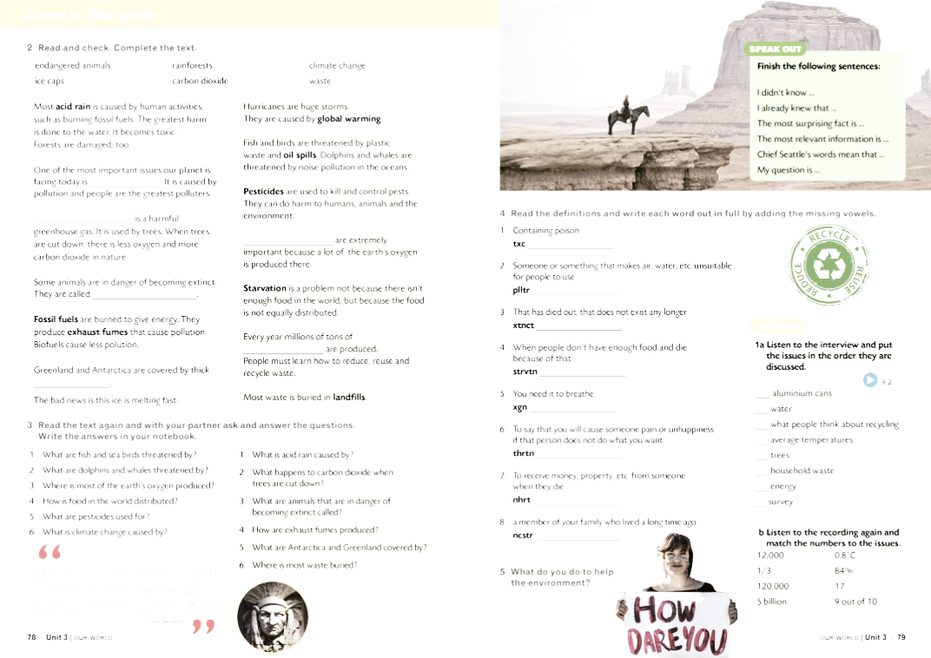

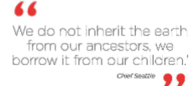
BRAINSTORMING
ECOLOGY
environmental problems
ENVIRONMENT

Slide 4
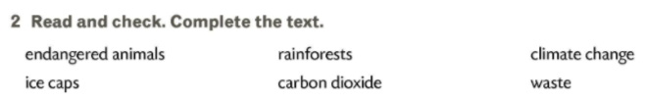
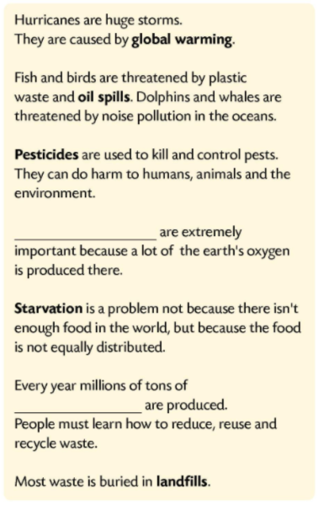
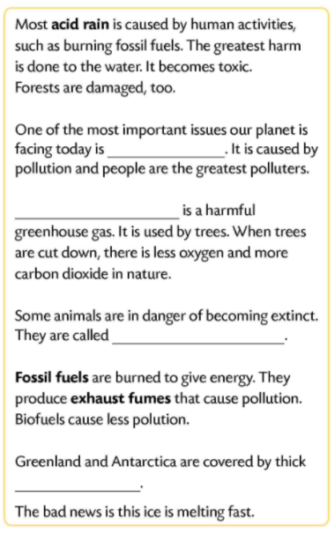
Pročitaj i provjeri. Dopuni tekst.
climate change
Carbon dioxide
Rainforests
endangered animals
waste
ice caps

Slide 5
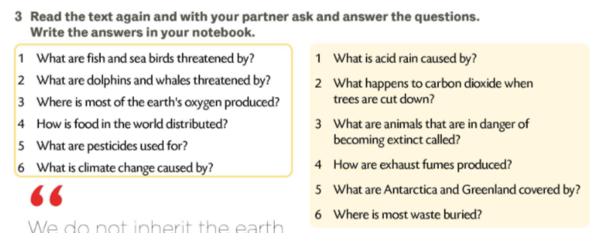


give energy
kill and control pests
pollution
trees

Slide 6
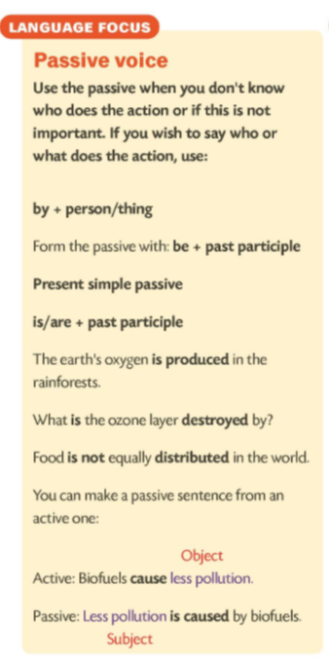
Fossil fuels are burnt to give energy.
Pesticides are used to kill and control pests.
People burn fossil fuels to give energy.
People use pesticides to kill and control pests.
Climate change is caused by pollution.
Carbon dioxide is used by trees.
by phrase
the agent (doer of the action)

Slide 7
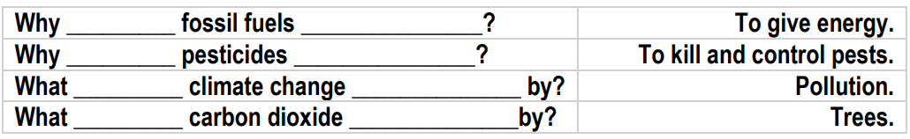
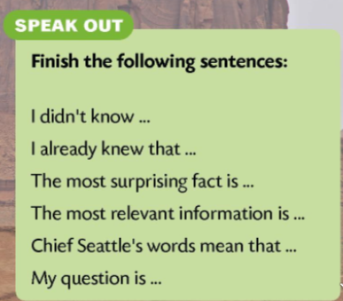

are
burnt
are
used
is
caused
is
used

